Slide 1




Rendering on browsers responsive to head position and environmental conditions
Sowmya Sunkara, Ravitheja Tetali, Joy Bose
Samsung R&D Bangalore
INDICON 2014

Slide 2
Existing responsiveness

Slide 3

Content

Slide 4
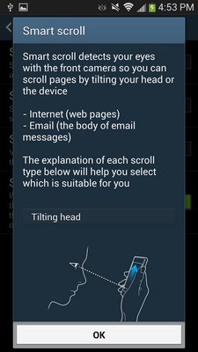
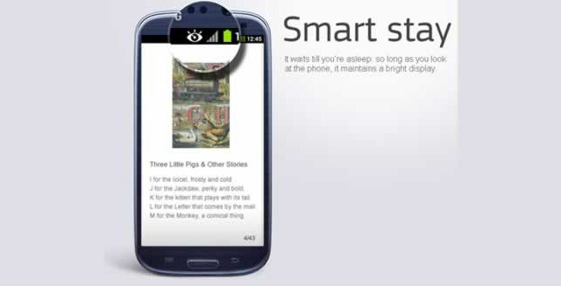
Device

Slide 5
Scope to do more?

Slide 6
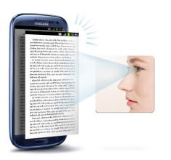
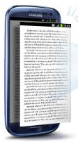


Responsive Rendering
Currently, the rendered webpage remains the same, irrespective of whether the user moves-away-from or comes-closer-to the device.
The zoom-level can vary based on the distance at which the device is held.

Slide 7
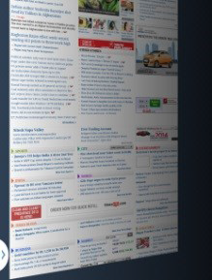
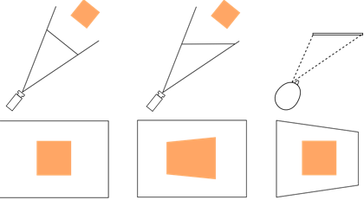
Head coupled perspective

Slide 8
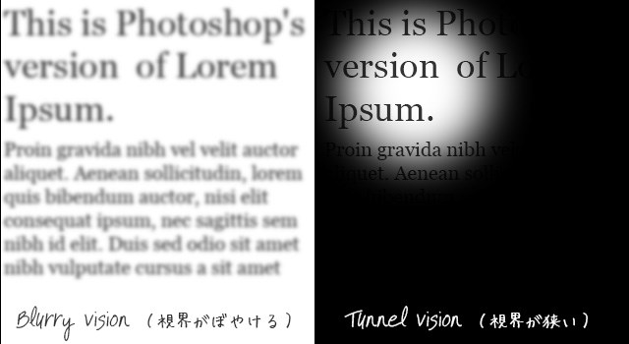
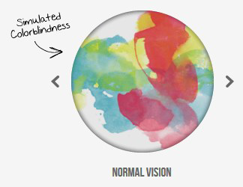
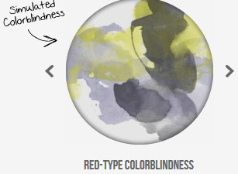
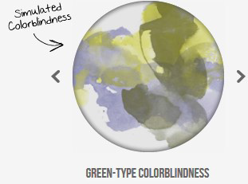
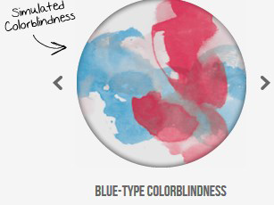
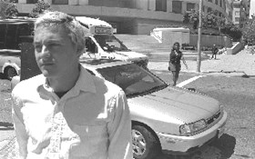
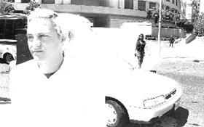
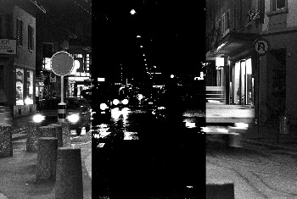
Adaptive Rendering
Currently, the webpage is rendered in the same fashion, irrespective of the user’s vision requirements.
The webpage rendering can take into account the user’s specific vision requirements. It should also adapt to the change in user’s vision requirements with time

Slide 9
How would it work?

Slide 10
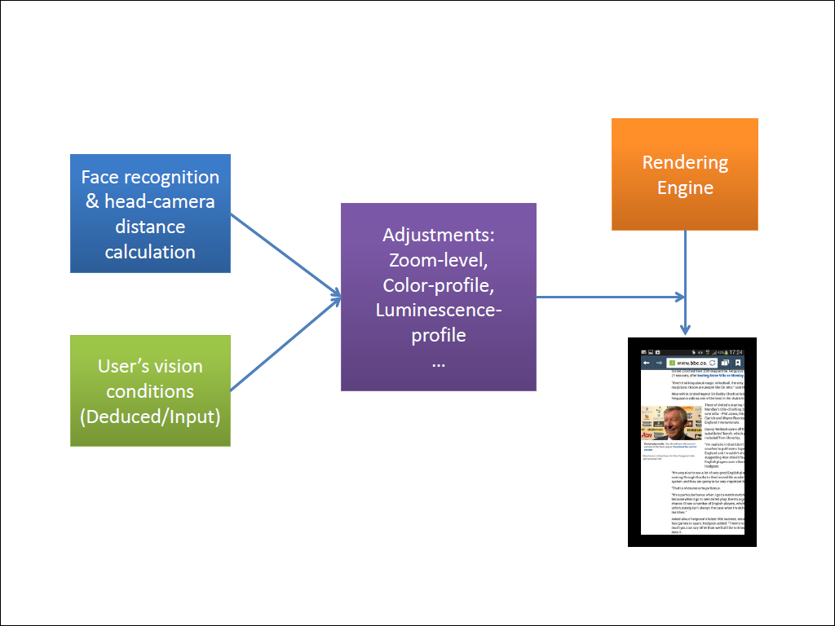

Slide 11
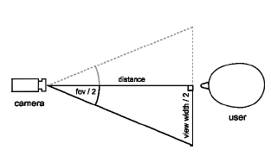
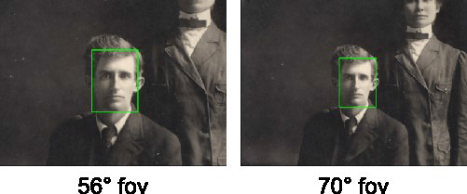
Head position tracking
The head-camera distance is deduced geometrically.
Existing OpenCV libraries are available for head tracking

Slide 12
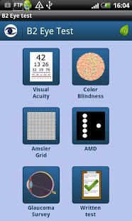
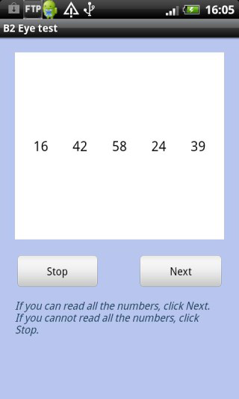
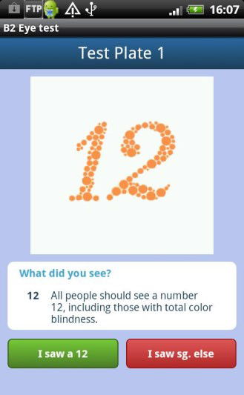
User’s vision requirements
Option 1: Run sample tests on device to deduce the user’s ophthalmological conditions.
Option 2: Provide settings-fields for the users to input values from their vision check-up reports.

Slide 13
Adjustments
Zoom-level:
We alter the zoom-level of the page, based on the distance at which the device is held from the user.
Zoom-level adjustment also depends on the user’s vision conditions (Myopic/Hyperopic/Tunnel-vision/etc).
Color-profile:
Depending on the type of user’s color-blindness, if any:
Change the color-profile across the webpage such that user can distinguish different regions
Give audio-feedback of the color in a region, upon hover-gesture.
Brightness/contrast profiles:
Can be varied according to ambient light intensity. Also, caters to the night-blind/day-blind.

Slide 14
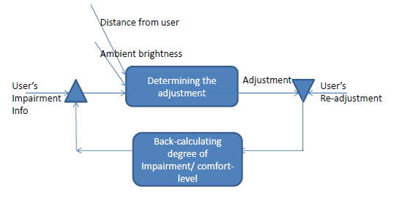
Feedback Mechanism
The system would have a feedback-mechanism such that it constantly re-adjusts (long term) to get closer to their comfort-levels and adapts to their changing vision-requirements.

Slide 15
Approaches
Browser-extension.
OpenCV module + rendering-engine.
System wide service.

Slide 16
Browser Extension
Advantages:
–Easier to develop (javascript).
–Easy to deploy (irrespective to browser version /upgrade).
Disadvantages:
–Extension Framework not enabled in our browser
–WebRTC needs to work seamlessly to get the face-detection/headtracking right.
–Interacting with native components like keypad, if need be, might be tricky.
–JS execution might degrade browser performance.
–JS execution is slower when compared to native code.

Slide 17
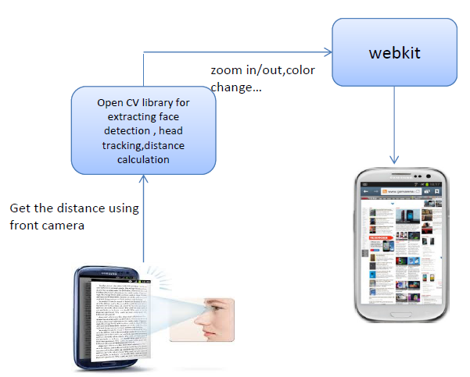
OpenCV + Rendering Engine

Slide 18
OpenCV + Rendering Engine
Advantages:
–Native code execution is faster.
–Interacting with native components is easier.
Disadvantages:
–Need to check the opencv module integration with the webkit.
–Performance of browser might degrade if we continously get the data.
–Need to merge the module whenever webkit version upgrades.
–Development in native is tougher.

Slide 19
System Wide Service
Advantages:
–Interacting with native components is easier.
–Can extend this service to all the components like contacts, messaging etc
Disadvantages:
–Need to modify android framework code which will take more development time.
–Need to update the module whenever framework version upgrades.

Slide 20
Implementation Screenshots

Slide 21
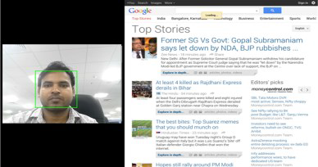
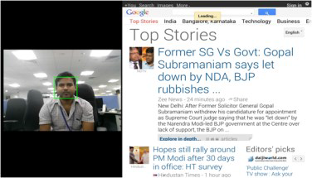
Screenshot: Changing font size
Decrease font size by 1 for each 10 cm head movement towards screen
Increase font size by 1 for each 10 cm head movement away from screen

Slide 22
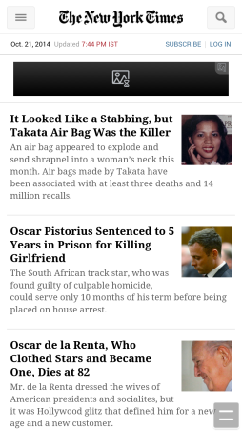

Screenshot: Rendering adjustments with Environmental conditions
Normal Webpage
Rendering webpage in night mode when
Illuminance (Lux value) less than threshold

Slide 23
Thanks for listening! Questions?

